Slide 1
Progress Meeting
27-10-2026
HANZE SAFEGO · US-1 / US-2 OUT-OF-PLANE TESTS IN 3DEC
Base shear · Pushover and hinge mechanism · Route 2 periods · Results
Yopi Oktiovan · with Ihsan and Eleni
Notes:
Four parts: the base-shear recheck against Ihsan and Eleni’s formula, what the pushover and the mechanical hinge model now tell us, why Route 2 uses T_p and T_m, then the full 25-run results.

Slide 2
The group’s formula, rechecked: it holds
1 · BASE SHEAR
V = g · 165 kg · (a13 + a14)
+ 12.94 kN · (f15a15 + f16a16 + f17a17)
US-1 peak
10.6 kN
Sensor | Height | Mass
a15 | 0.66 m | 491 kg
a16 | 1.26 m | 358 kg
a17 | 2.06 m | 470 kg
wall only 8.7 kN
US-2 peak
12.6 kN
Slabs a13/a14 at 165 kg each · wall split by sensor height (Test_Info F16–F18) · no top beam
wall only 10.7 kN
To confirm: slab mass 165 vs 120 kg · top beam 61.4 vs 151.4 kg (and its lateral restraint) · US-1 run 18 channel slip of 1.36 s
Notes:
Our independent recheck from the raw channels reproduces Ihsan and Eleni’s formula. All plots in this meeting use it (processed set v3). Three things still to confirm with them: the slab mass, the top-beam mass and whether it is laterally restrained, and a 272-sample (1.36 s) slip between channels in US-1 run 18.

Slide 3
The earlier processed files (Alvand) read about 35 % high
1 · BASE SHEAR
Earlier processed files
Group formula (v3)
V = λ · Σ mj (aj + a12)
V = Σ mj aj on absolute channels
λ = 2.317 (origin unknown) · masses from ρ = 1619 kg/m³ · table acceleration a12 added to channels that are already absolute
masses from the weighed wall and slabs · no double-counted table motion · no factor
14–16 kN
10.6 / 12.6 kN
test peaks used until 5 October
US-1 / US-2 peaks
Consequence: the model’s base shear was judged against tests that were too high; on the corrected basis the model sits above the tests (results section)
Notes:
The earlier processed test files added the table acceleration (channel 12) to the wall channels, which are already absolute, and multiplied by a factor of 2.317 whose origin we never confirmed. That reads about 35 % high: 14–16 kN instead of 10.6 kN (US-1) and 12.6 kN (US-2). This changes the earlier conclusion: the model was matching inflated test values.

Slide 4
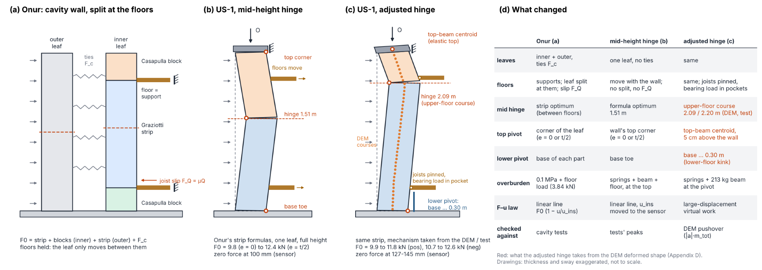
Mechanical model: hinge moved up to the upper floor
2 · PUSHOVER
2.09 m
9.9–11.8 kN
≈ 28 mm
hinge, as in DEM and test
F0, positive push
at 80 % V (test 27.4 mm)
Notes:
Starting from Onur’s strip formulas, the mid-height hinge (1.51 m) zeroes at 100 mm. Taking the mechanism from the DEM and the test (hinge in the upper-floor course at 2.09 m, top pivot at the top-beam centroid, joists pinned and bearing load in the pockets) gives F0 of 9.9–11.8 kN and a displacement at 80 % of the peak of about 28 mm, right on the US-1 envelope end (27.4 mm).

Slide 5
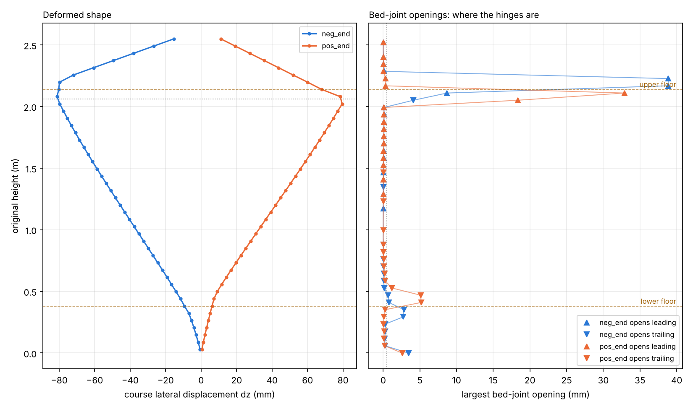
DEM ft = 0 deformed shape: where the wall hinges
2 · PUSHOVER
2.05–2.17 m
upper hinge, in the floor course: 33 mm (+) / 39 mm (−)
0.3–0.5 m
lower kink at the joist: 3–5 mm
No mid-height
hinge at 1.51 m
All joints ft = 0 · end of push, ≈ 80 mm at the 2.06 m sensor · this shape set the adjusted hinge (2.09 / 2.20 m) and the lower pivot (base … 0.30 m)
Notes:
This is the deformed shape at the end of the f_t = 0 pushover in both directions, read course by course from the 3DEC save. The wall does not hinge at mid-height as the textbook mechanism assumes. The main hinge forms in the upper-floor course, at 2.05–2.11 m on the positive push and 2.11–2.17 m on the negative push, and the wall kinks a few millimetres at the lower joist, around 0.3–0.5 m, instead of pivoting cleanly at the base. That is exactly what the adjusted mechanical model takes from the DEM: hinge at 2.09 or 2.20 m and a lower pivot between the base and 0.30 m.

Slide 6
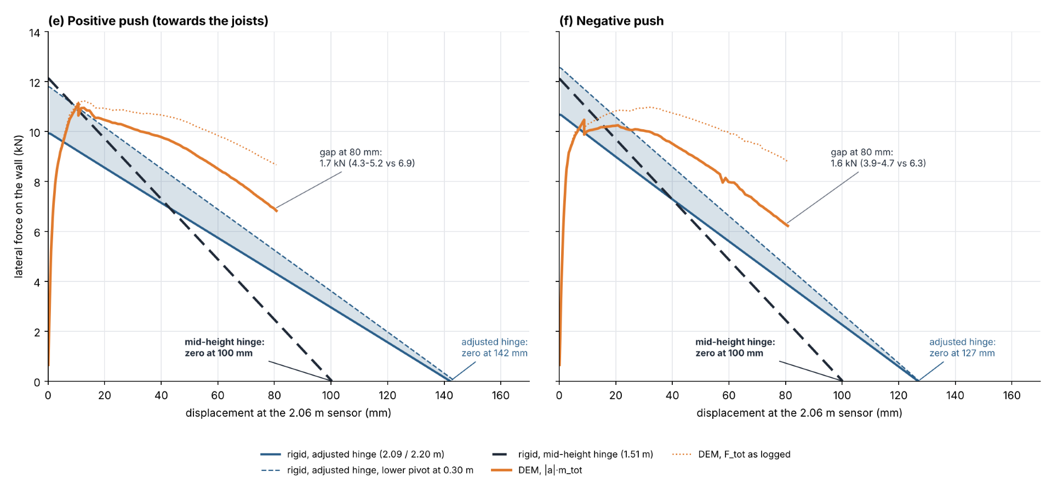
DEM (ft = 0) carries more than the rigid mechanism
2 · PUSHOVER
DEM reaches 80 % V at 57 mm, the test at 27 mm · no compressive damage in the DEM
Notes:
Same peak, but the DEM softens far more slowly: at 80 mm it is still 1.6–1.7 kN above the adjusted rigid line, and it reaches 80 % of the peak at about 57 mm against 27 mm in the test. The next slides find where that extra force comes from.

Slide 7
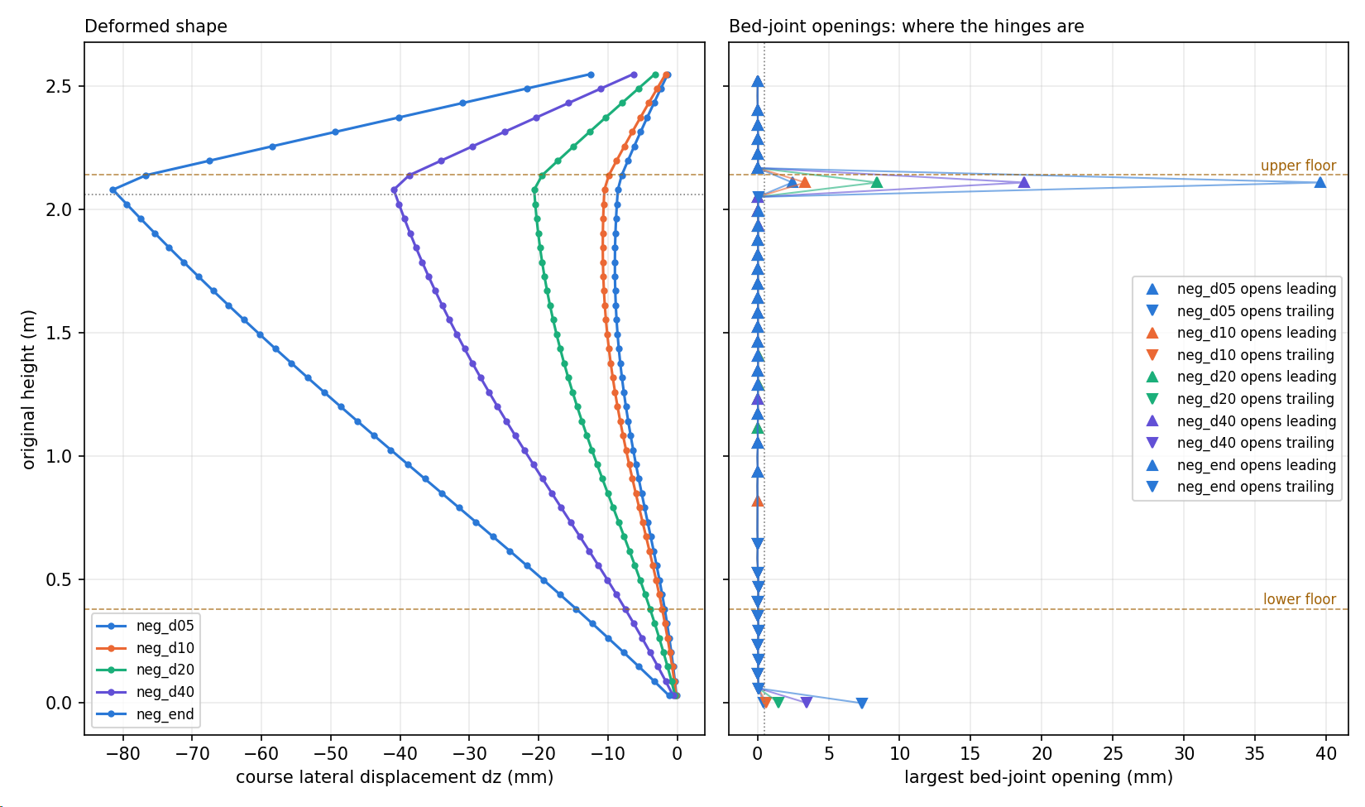
Forced hinges: right mechanism, force still too high
2 · PUSHOVER
ft = 0 only at base, 2.110 m joint, top; 0.344 MPa elsewhere
d | DEM | Rigid
20 mm | 10.9 kN | 8.6 kN
40 mm | 10.6 kN | 7.2 kN
77 mm | 9.7 kN | 4.5 kN
Exactly three hinges: base 6.9 mm, 2.110 m 40.4 mm, top-beam pivot
Notes:
To test the mechanism directly we unbonded only the three hinge joints and kept the characterisation strengths everywhere else. The DEM then forms exactly the rigid model’s three hinges and nothing else opens, yet it still carries 2–5 kN more than the rigid model at the same displacement. So the gap is not the mechanism.

Slide 8
The extra work is friction in the joist pocket
2 · PUSHOVER
Push work to 80 mm = potential energy + dissipated
Forced hinges
PE 268 J
152 J
420 J
All ft = 0
PE 261 J
80 J
341 J
≈ 130 J
≤ 10 J
≈ 75 %
0.73 × 44 kN × 4 mm joist slip
all hinge joints (≈ no slip)
of the wall load goes through the rigid joist
Frictionless pockets: joists slide out already under gravity · next: timber friction (μ ≈ 0.5) in the pockets
Notes:
Energy balance at 80 mm: the forced-hinge push does 420 J of work, 268 J goes into lifting the wall and the springs, 152 J is dissipated. With all joints at f_t = 0 the dissipated part is 80 J. The hinges have identical properties in both models and barely slip, so they cannot explain the doubling; the lower pocket’s normal force does double (24 to 44 kN), and 0.73 × 44 kN × 4 mm of joist slip is about 130 J. The force is so large because the rigid joist block attracts about 75 % of the wall’s vertical load at that level. A frictionless-pocket run is going now as the check.

Slide 9
Ihsan’s idea: take the sine period from the record (Tp)
3 · ROUTE 2 PERIODS
T1 0.09–0.11
Tm 0.206
Teff 0.357
HU12 record, seconds
0 s
Tp 0.121
0.6 s
3.6 ×
5 ×
21 / 25
record PGA needed by wave B (2.85 g at run 21)
overshoot of the Sd(T1) target: Tp sits next to T1
runs flagged with Tp for both waves
Notes:
The idea is right in spirit: the period should come from the record, not from the wall. The problem is HU12: its T_p of 0.121 s is a third of T_eff. A one-cycle sine that short only pushes a long-period oscillator through its ground displacement, so the acceleration needed grows as Sd over T_p squared: 3.6 times the record PGA, 2.85 g at run 21. And because 0.121 s sits right next to T1, the same wave drives Sd(T1) to five times its target.

Slide 10
Wave A at Tp, wave B at Rathje’s mean period Tm
3 · ROUTE 2 PERIODS
Record | Tp (s) | Tm (s)
HU12 | 0.121 | 0.206
EC40 | 0.251 | 0.544
FR76 | 0.261 | 0.374
Tm = Σ (Ci² / fi) / Σ Ci²
Ci = Fourier amplitudes of the record acceleration, 0.25 ≤ fi ≤ 20 Hz
Rathje, Abrahamson & Bray (1998); Rathje et al. (2004)
(Tm, Tm)
(Tp, Tp)
(Tp, Tm)
8 runs flagged: one shape cannot meet two targets
21 runs flagged: 3 × PGA on HU12
0 flagged: both targets met on all 25 runs
Notes:
T_m is a standard, wall-independent measure of a record’s frequency content, and it lies much closer to T_eff than T_p does. Both periods still come from the record, as Ihsan wanted, but they give two different spectral shapes, so wave A can hit Sd(T1) and wave B Sd(T_eff) independently. In the preflight, all-T_m collapses to one wave on 8 runs, all-T_p is infeasible on 21, and T_p plus T_m meets both targets on all 25 runs. FLAG LEGEND (preflight check on the designed table signal, before 3DEC; a flag says the input is a problem, not the model): pga = signal PGA above the allowed multiple of the scaled record PGA. table = signal PGA above what the shake table reached (about 0.78 g). leakA = wave B alone already overshoots the Sd(T1) target, so the run collapses to wave B. leakB = wave A alone already overshoots the Sd(T_eff) target, so the run collapses to wave A. (T_m, T_m), 8 runs, leakB: both cycles at one period give one spectral shape, so Sd(T_eff)/Sd(T1) is fixed by T_m; a cycle sized for Sd(T1) overshoots Sd(T_eff) by 14 % (HU12), 33 % (FR76), 76 % (EC40). (T_p, T_p), 21 runs, pga / table / leakA: HU12 T_p 0.121 s is a third of T_eff, so the needed acceleration grows as Sd/T_p^2 (3.6x record PGA, 2.85 g at run 21); and 0.121 s sits next to T1, so Sd(T1) overshoots 4-5x. (T_p, T_m), 0 runs: two periods, two spectral shapes, both targets met independently.

Slide 11
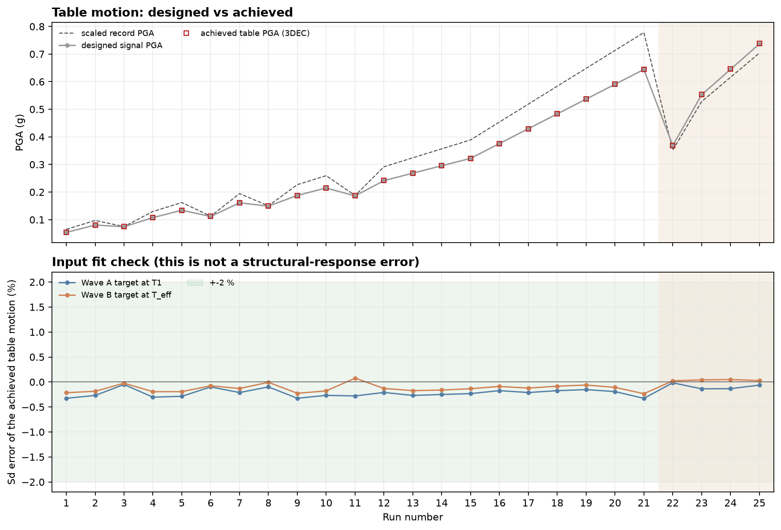
Input: the table delivers the designed signal
4 · RESULTS
< 0.5 %
Sd error, both waves, all 25 runs
0.74 g
highest table PGA (run 25); below the record on HU12
Notes:
Before reading the response: the input is what we designed. Achieved table PGA equals the designed signal, and the spectral targets at T1 and T_eff are met within half a percent on every run. On the HU12 runs the surrogate even needs less PGA than the scaled record.

Slide 12
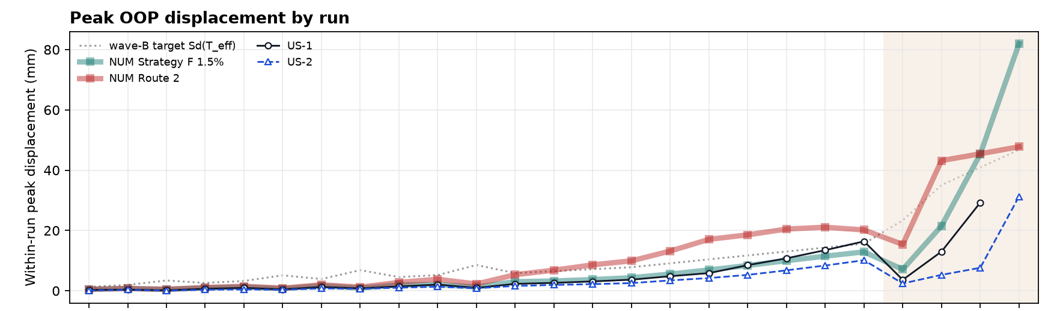
Peak displacement: Strategy F tracks US-1, Route 2 runs high
4 · RESULTS
Peak (mm) | Route 2 | Strategy F | US-1
Run 15 | 9.9 | 4.3 | 3.7
Run 21 | 20.2 | 12.9 | 16.4
Run 24 | 45.4 | 45.3 | 29.3
x-axis: runs 1–25, shaded = FR76 (22–25)
Notes:
Strategy F, the record on the model, follows US-1 closely up to run 21. Route 2 runs about twice the test from run 13 to 21. In the FR76 sequence both models overshoot: at run 24 both reach about 45 mm against 29 mm in US-1.

Slide 13
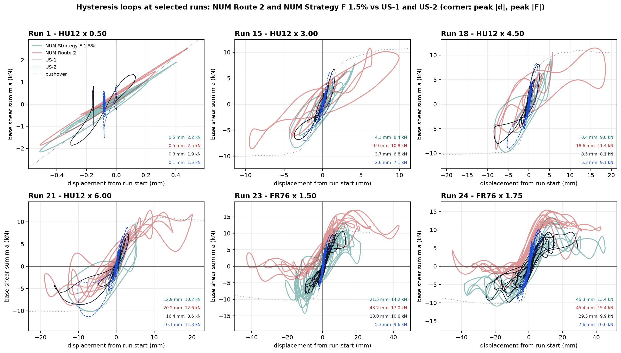
Hysteresis loops at six runs
4 · RESULTS
Notes:
Run 1 shows the initial stiffness agrees. From run 15 on, Route 2’s loops are much wider and longer than the tests; Strategy F stays close to the test loops until the FR76 runs, where it also runs out to large displacements on the negative side.

Slide 14
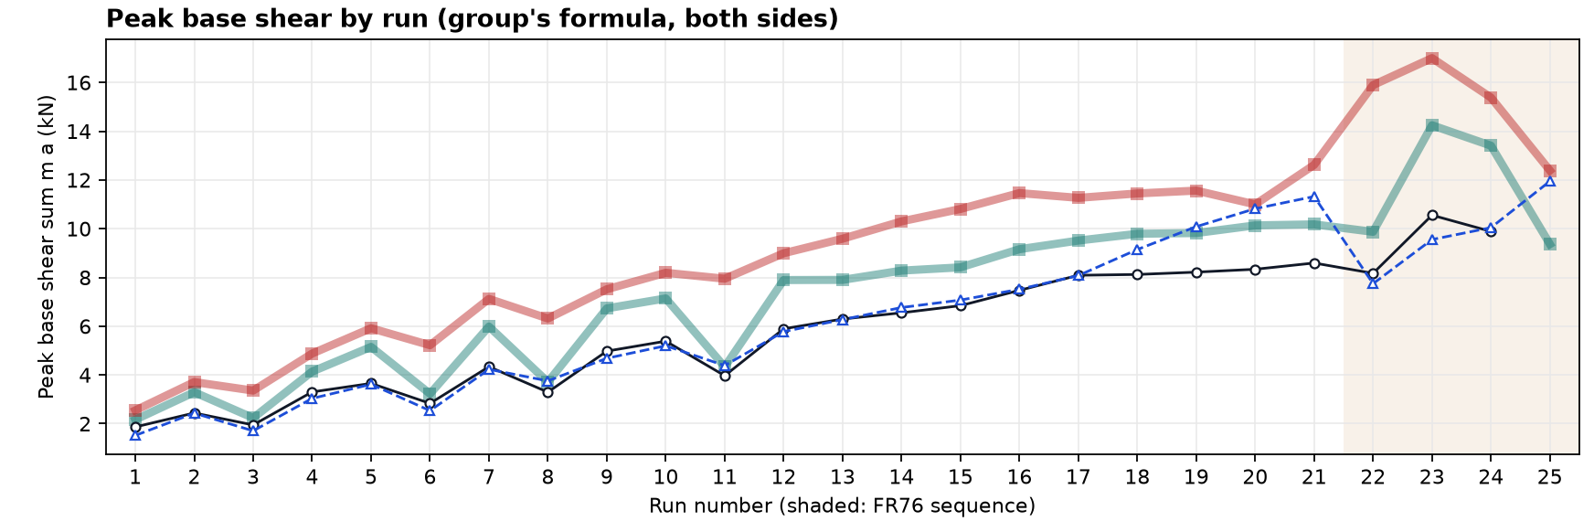
Peak base shear: both models above the tests
4 · RESULTS
17.0 kN
14.2 kN
10.6 kN
Route 2, run 23
Strategy F, run 23
US-1, run 23
Notes:
With the corrected test basis, both models carry more base shear than the specimens: Strategy F by roughly 1.2 times, Route 2 by up to 1.6 times in run 23. This is the same excess force the pushover shows, which points back at the joist pocket.

Slide 15
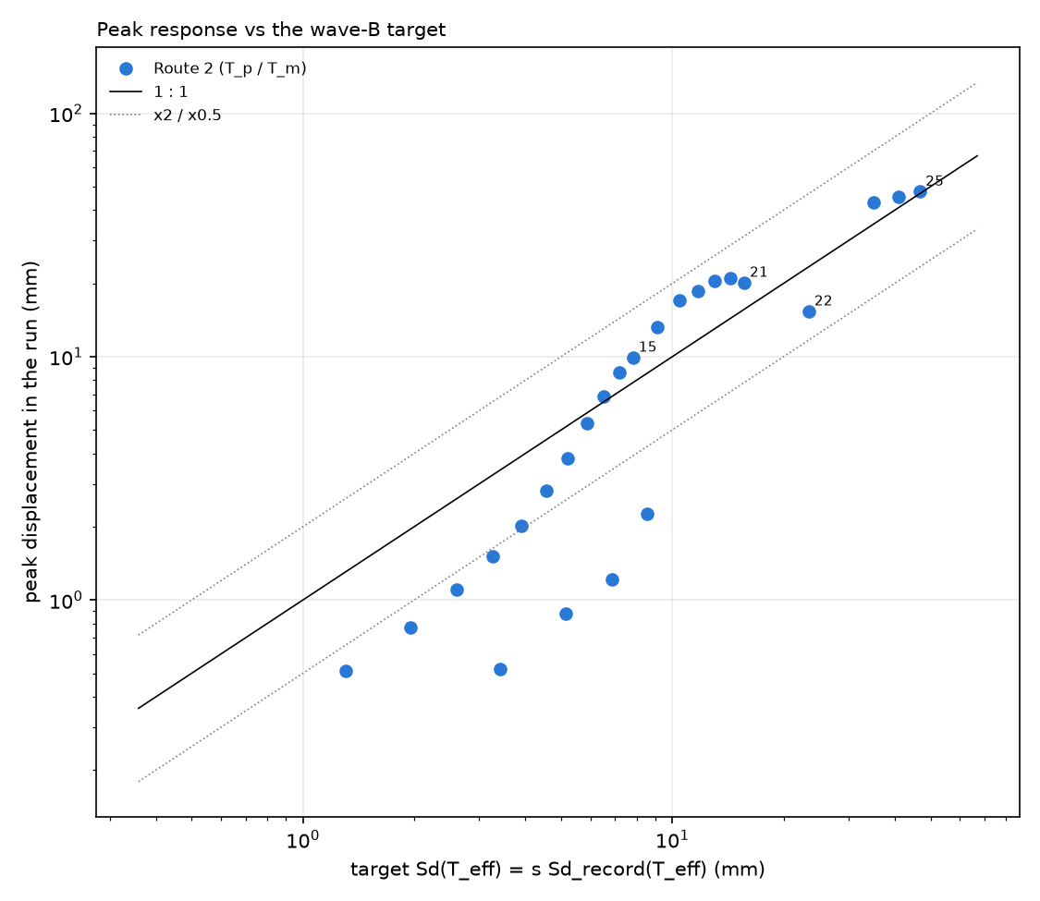
Route 2 delivers its own target
4 · RESULTS
Target ≥ 5 mm
response within ×2 of Sd(Teff)
Target < 5 mm
below 1 : 1: wall still elastic, T1 governs
The target is the issue
Teff 0.344 s from the ft = 0 push; restart with 0.36 s, T1 0.089 s
Notes:
The method does what it is asked: once the wall rocks, its peak follows the Sd(T_eff) target within a factor of two. Below about 5 mm the wall is still elastic and T_eff is not the governing period, so it falls short of the line. The overshoot against the tests therefore comes from the target itself, set from the f_t = 0 pushover. The restart uses T1 0.089 s and T_eff 0.36 s from the mechanical model.

Slide 16
Next steps
Base shear
Pushover
Group formula adopted · confirm slab and beam masses, run-18 slip
Timber friction and softer joist bearing in the pockets · ft sweep 0.05–0.10 MPa running
Route 2
Damping
Keep (Tp, Tm) · restart with T1 0.089 s, Teff 0.36 s
Measured ζ ≈ 0.9–1.7 % supports 1.5 % Maxwell
Notes:
Summary of decisions to take from today: adopt the group’s base-shear formula, keep the T_p plus T_m surrogate and rerun it with the targets from the mechanical model, and fix the joist-pocket representation, which is where the extra force and dissipation come from. Measured small-amplitude damping is 0.9 % (ring-down) to 1.7 % (half-power), which supports the 1.5 % Maxwell damping used throughout.

